Slide 1

Week 4 – OOP II
EE422C - Software Design and Implementation II • Fall 2017
(Slides modified from originals by Prof. Mike Scott)

Slide 2

OOP helps manage the complexity of software projects

Slide 3

“Offers a clever way of breaking up software programming instructions and data into small, reusable objects, based on certain abstraction principles and design hierarchies”
-Michael A. Cusumano, The Business Of Software

Slide 4


Blueprint analogy
Audio Player blueprint
state: current song volume battery life
behavior: power on/off change station/song change volume choose random song
creates
Audio Player #1
state: song = "1,000,000 Miles" volume = 17 battery life = 2.5 hrs
behavior: power on/off change station/song change volume choose random song
Audio Player #2
state: song = "Letting You" volume = 9 battery life = 3.41 hrs
behavior: power on/off change station/song change volume choose random song
Audio Player #3
state: song = "Discipline" volume = 24 battery life = 1.8 hrs
behavior: power on/off change station/song change volume choose random song

Slide 5
The three principles of OO SE
Encapsulation
Keep variables and the operations performed on those variables together.
Inheritance
Each subclass inherits all members of its superclass
Polymorphism
Calling interface is the same despite different data types altering behavior
car
Super class
manual
automatic
Subclasses
var
draw()
draw()

Slide 6
Encapsulation
Encapsulation is the mechanism that binds together the code and data it manipulates into a logical black box that is safe from outside interference and misuse
Let’s see an example…

Slide 7
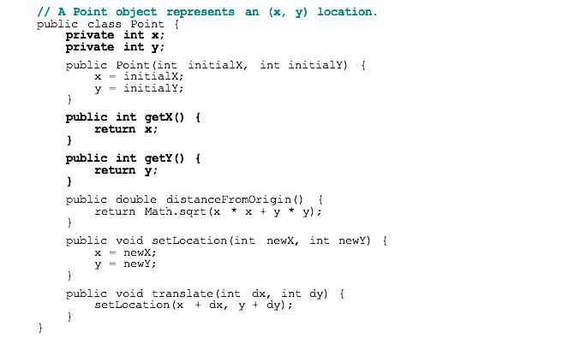

Slide 8
Private fields
A field that cannot be accessed from outside the class
private type name;
Examples:
private int id;
private String name;
Client code won't compile if it accesses private fields:
PointMain.java:11: x has private access in Point
System.out.println(p1.x);
^

Slide 9
Accessing private state
// A "read-only" access to the x field ("accessor")
public int getX() {
return x;
}
// Allows clients to change the x field ("mutator")
public void setX(int newX) {
x = newX;
}
Client code will look more like this:
System.out.println(p1.getX());
p1.setX(14);

Slide 11
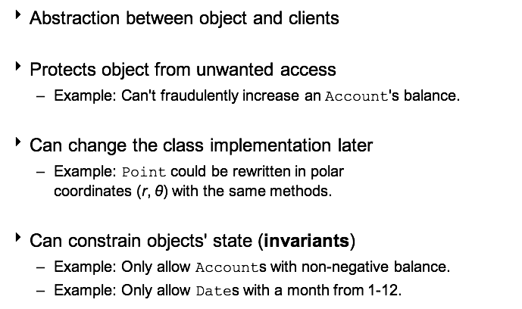
Encapsulation

Slide 12
Inheritance
The process by which one class acquires the properties (data members) and functionalities (methods) of another class.
superclass
A
Is-a
type
of
“extends”
B
subclass

Slide 13
class Driver extends Person
{ long driversLicenseNumber; Date expirationDate; }
class Student extends Person
{
String studentID;
. . .
}

Slide 14
Why Inheritance?
Existing classes can be the foundation for new classes
Break software into more manageable pieces
Inheritance provides the reusability of code so that a class has to write only unique features; the rest of the common properties and functionalities can be extended from the another class.

Slide 15
Overriding vs Overloading Methods
A method is overloaded if it has multiple definitions that are distinguished from one another by having different numbers or types of parameters
Methods with the same name but different parameters are overloaded
A method is overridden when a subclass gives a different definition of the method with the same number and types of parameters
Methods in the class hierarchy which have the same name, return type, and parameters override corresponding inherited methods

Slide 16
Overloading a Method
class A
{ int i, j;
A(int a, int b) { i = a; j = b;}
void show( ) { System.out.println("i and j: " + i + " " + j); }
}
class B extends A
{ int k;
B(int a, int b, int c)
{ super(a, b);
k = c;
}
void show(String msg) { System.out.println(msg + k); } // overloaded show( )
}
class Demo
{ public static void main(String args[])
{
B subOb = new B(1, 2, 3);
subOb.show ("This is k: "); // this calls show() in B
subOb.show ( ); // this calls show() in A
}
}
Methods with differing type signatures are overloaded -- not overridden.

Slide 17
Overriding a Method
class A
{ int i, j;
A(int a, int b)
{ i = a;
j = b;
}
void show( ) { System.out.println("i and j: " + i + " " + j);}
}
class B extends A
{ int k;
B(int a, int b, int c)
{ super(a, b);
k = c;
}
void show( ) { System.out.println("k: " + k); } // overrides show () in A
}
class Demo
{ public static void main(String args[ ])
{ B subOb = new B(1, 2, 3);
subOb.show( ); // this calls show() in B
subOb.super.show( ); // this calls show() in A
}
}

Slide 18
Polymorphism
The provision of a single interface to entities of different types

Slide 19
Binding
Consider the following method invocation:
obj.doIt();
At some point, this invocation is bound to the definition of the method that it invokes
If this binding occurred at compile time, then that line of code would call the same method every time

Slide 20
Dynamic Binding
However, Java defers method binding until run time -- this is called dynamic binding or late binding
Late binding provides flexibility in program design

Slide 21
Shape
void draw()
void erase()
is-a
Triangle
Rectangle
Circle
void draw()
void erase()
void draw()
void erase()
void draw()
void erase()

Slide 22
Polymorphism
object variables can refer to objects of their declared type AND any objects that are descendants of the declared type
Shape s = new Shape(); s = new Rectangle(); // legal! s = new Circle(); //legal!
Object obj1; // = what?
obj1 = s; // legal?

Slide 23
Polymorphism
Shape s;
Random rand = new Random(); if (rand.nextBoolean())
s = new Rectangle(); //upcasting else s = new Circle();
s.draw();

Slide 24
Compile Time Poly
class DemoOverload
{ public int add(int x, int y) { return x+y; //method 1}
public int add(int x, int y, int z) {return x+y+z; //method 2 }
public int add(double x, int y) {return (int)x+y; //method 3}
public int add(int x, double y) {return x+(int)y; //method 4}
}
class Test
{ public static void main(String[ ] args)
{ DemoOverload demo=new DemoOverload(); System.out.println(demo.add(2,3)); //method 1 called System.out.println(demo.add(2,3,4)); //method 2 called
System.out.println(demo.add(2.5,3)); //method 3 called System.out.println(demo.add(2,3.4)); //method 4 called
}
}

Slide 25
Method LookUp
To determine if a method is legal the compiler looks in the class based on the declared type
if it finds it great, if not go to the super class and look there
continue until the method is found, or the Object class is reached and the method was never found. (Compile error)
To determine which method is actually executed the Java run time system:
starts with the actual run time class of the object that is calling the method
search the class for that method
if found, execute it, otherwise go to the super class and look there, if not found keep looking up the chain
repeat until a version is found
If not found then throw an exception

Slide 26
Run Time Poly
class Vehicle
{ public void move() { System.out.println(“Vehicles can move!!”); }
}
class MotorBike extends Vehicle
{ public void move()
{ System.out.println(“MotorBike can move and accelerate too!!”); }
}
class Test
{ public static void main(String[ ] args)
{ Vehicle vh = new MotorBike();
vh.move(); // prints MotorBike can move and accelerate too!!
vh = new Vehicle();
vh.move(); // prints Vehicles can move!!
}
}

Slide 27
A polymorphism problem
Suppose that the following four classes have been declared:
public class Foo
{
public void method1() {System.out.println("foo 1");}
public void method2() {System.out.println("foo 2");}
public String toString() {return "foo”;}
}
public class Bar extends Foo
{
public void method2() {System.out.println("bar 2");}
}
public class Baz extends Foo
{
public void method1() {System.out.println("baz 1");}
public String toString() {return "baz”;}
}
public class Mumble extends Baz
{
public void method2() {System.out.println("mumble 2");}
}

Slide 28
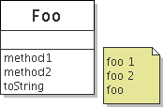
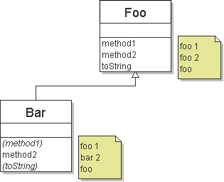
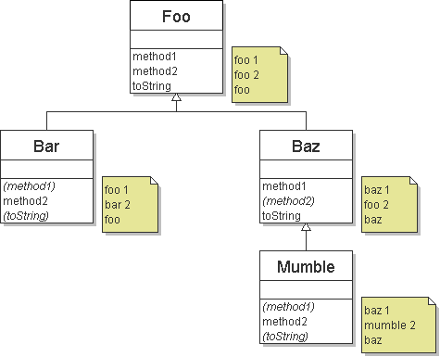
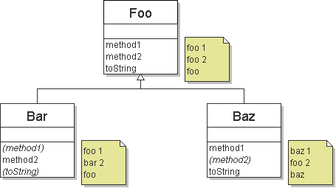
Diagramming the classes & output
Add classes from top (superclass) to bottom (subclass).
Include all inherited methods. Show the method outputs.

Slide 29
A polymorphism problem
What would be the output of the following client code?
Foo[] pity = {new Baz(), new Bar(), new Mumble(), new Foo()};
for (int i = 0; i < pity.length; i++)
{
System.out.println(pity[i]);
pity[i].method1();
pity[i].method2();
System.out.println();
}

Slide 30
Finding output with tables
Class
method | Foo | Bar | Baz | Mumble
method1
method2
toString
 | Foo | Bar | Baz | Mumble
method1 | foo 1 | foo 1 | baz 1 | baz 1
method2 | foo 2 | bar 2 | foo 2 | mumble 2
toString | foo | foo | baz | baz
method | Foo | Bar | Baz | Mumble
method1 | foo 1 |  | baz 1
method2 | foo 2 | bar 2 |  | mumble 2
toString | foo |  | baz
Notes:
It's annoying to flip back and forth between slides here. I suggest putting the classes into a text editor so you can switch windows back and forth to fill in the table.

Slide 31
Polymorphism answer
Foo[] pity = {new Baz(), new Bar(), new Mumble(), new Foo()};
for (int i = 0; i < pity.length; i++)
{
System.out.println(pity[i]);
pity[i].method1();
pity[i].method2();
System.out.println();
}
Output – make sure you understand this ex:
baz
baz 1
foo 2
foo
foo 1
bar 2
baz
baz 1
mumble 2
foo
foo 1
foo 2

Slide 32
Inner class example
Inner class: A class can be a member of another class
Can also be inside of any type of block (e.g. a loop)
Inner class variables can hide outer class variables
Advantages: In some applications, you can use an inner class to make programs simpler.
An inner class is used for supporting the work of its containing outer class/method, and it cannot be used by other classes.

Slide 33
Inner class example
class Outer
{
int outer_x = 100;
void test()
{ Inner myInner = new Inner();
myInner.display();
}
// this is an inner class
class Inner
{ int inner_y = 99;
void display()
{ System.out.println("display: outer_x = " + outer_x); }
}
}
class InnerClassDemo
{
public static void main(String args[ ])
{
Outer myOuter = new Outer();
myOuter.test();
}
}
System.out.println(inner_y); // error
inner class can access outer class variables
but not vice versa

Slide 34
the instanceof Operator
instanceof is a Java keyword.
part of a boolean statement
public boolean equals(Object otherObj) { if otherObj instanceof Person { //now go and cast // rest of equals method } }
If otherObj is a Person or can be cast to a Person (e.g. subclass objects) it evaluates to true. Otherwise false.

Slide 35
the instanceof Operator
Check that two Persons are equal:
public boolean equals (Object otherObject)
{ // 2 Persons are equal if their names are equal
if(otherObject instanceof Person)
{ Person other
= (Person)otherObject;
return
( getName().equals(other.getName()));
}
else return false;
}

Slide 36
A "Perfect" Equals Method
public boolean equals(Object otherObject)
{ // check if objects are identical
if( this == otherObject)
return true;
// must return false if explicit parameter null
if(otherObject == null)
return false;
// if objects not of same type they cannot be equal
if(this.getClass() != otherObject.getClass() )
return false;
// now we know otherObject is a non null Person
Person other = (Person)otherObject;
return ( getAge() == other.getAge()
&& getAddress().equals(other.getAddress())
&& getName().equals( other.getName() );
}
From Cay Horstmann's Core Java

Slide 37
The Object Class
The Object class is the root of all Java classes.
Every class that doesn’t extend another class extends the library class xObject
Inherited methods are:
String toString ()
boolean equals (Object other)
Object clone ()
The methods
The equals() method compares the contents of two objects.
The toString() method returns a string representation of the object.
The clone() method copy objects
A few others later
Object
equals()
toString()
clone()

Slide 38
The Object Class, cont.
The toString() method returns a string representation of the object.
The default implementation returns a string consisting of a class name of which the object is an instance, the at sign (@), and a (sequence) number representing this object.
If you want something different, override it

Slide 39
Overriding toString
Return a string containing the object’s key state variables, e.g.
public String toString( )
{ return getName( ) + " " + getAge( ) + " ” + getAddress() + “ “ + getPhoneNumber( );
}
toString() is automatically invoked when concatenating an object with a string:
Person myFriend = new Person(“you”,22,
“100 Longhorn, Austin, TX 77021”, “471-7777” );
System.out.print(“my friend = ” + myFriend);
Prints
my friend = . . .

Slide 40
The Object Class, cont.
The clone() method copies objects
To create a new object with separate memory space, use the clone() method, e.g.:
newObject = someObject.clone();
Not all objects can be cloned.
For an object to be cloneable, its class must implement the java.lang.Cloneable interface
more later on interfaces

Slide 41
Overriding clone
How to clone a Person:
public Object clone( )
{
Person clonedPerson = new Person( );
return clonedPerson;
}
Call clone:
Person friend1 = . . .;
Person friend2 =
(Person) friend1.clone();

